Slide 1



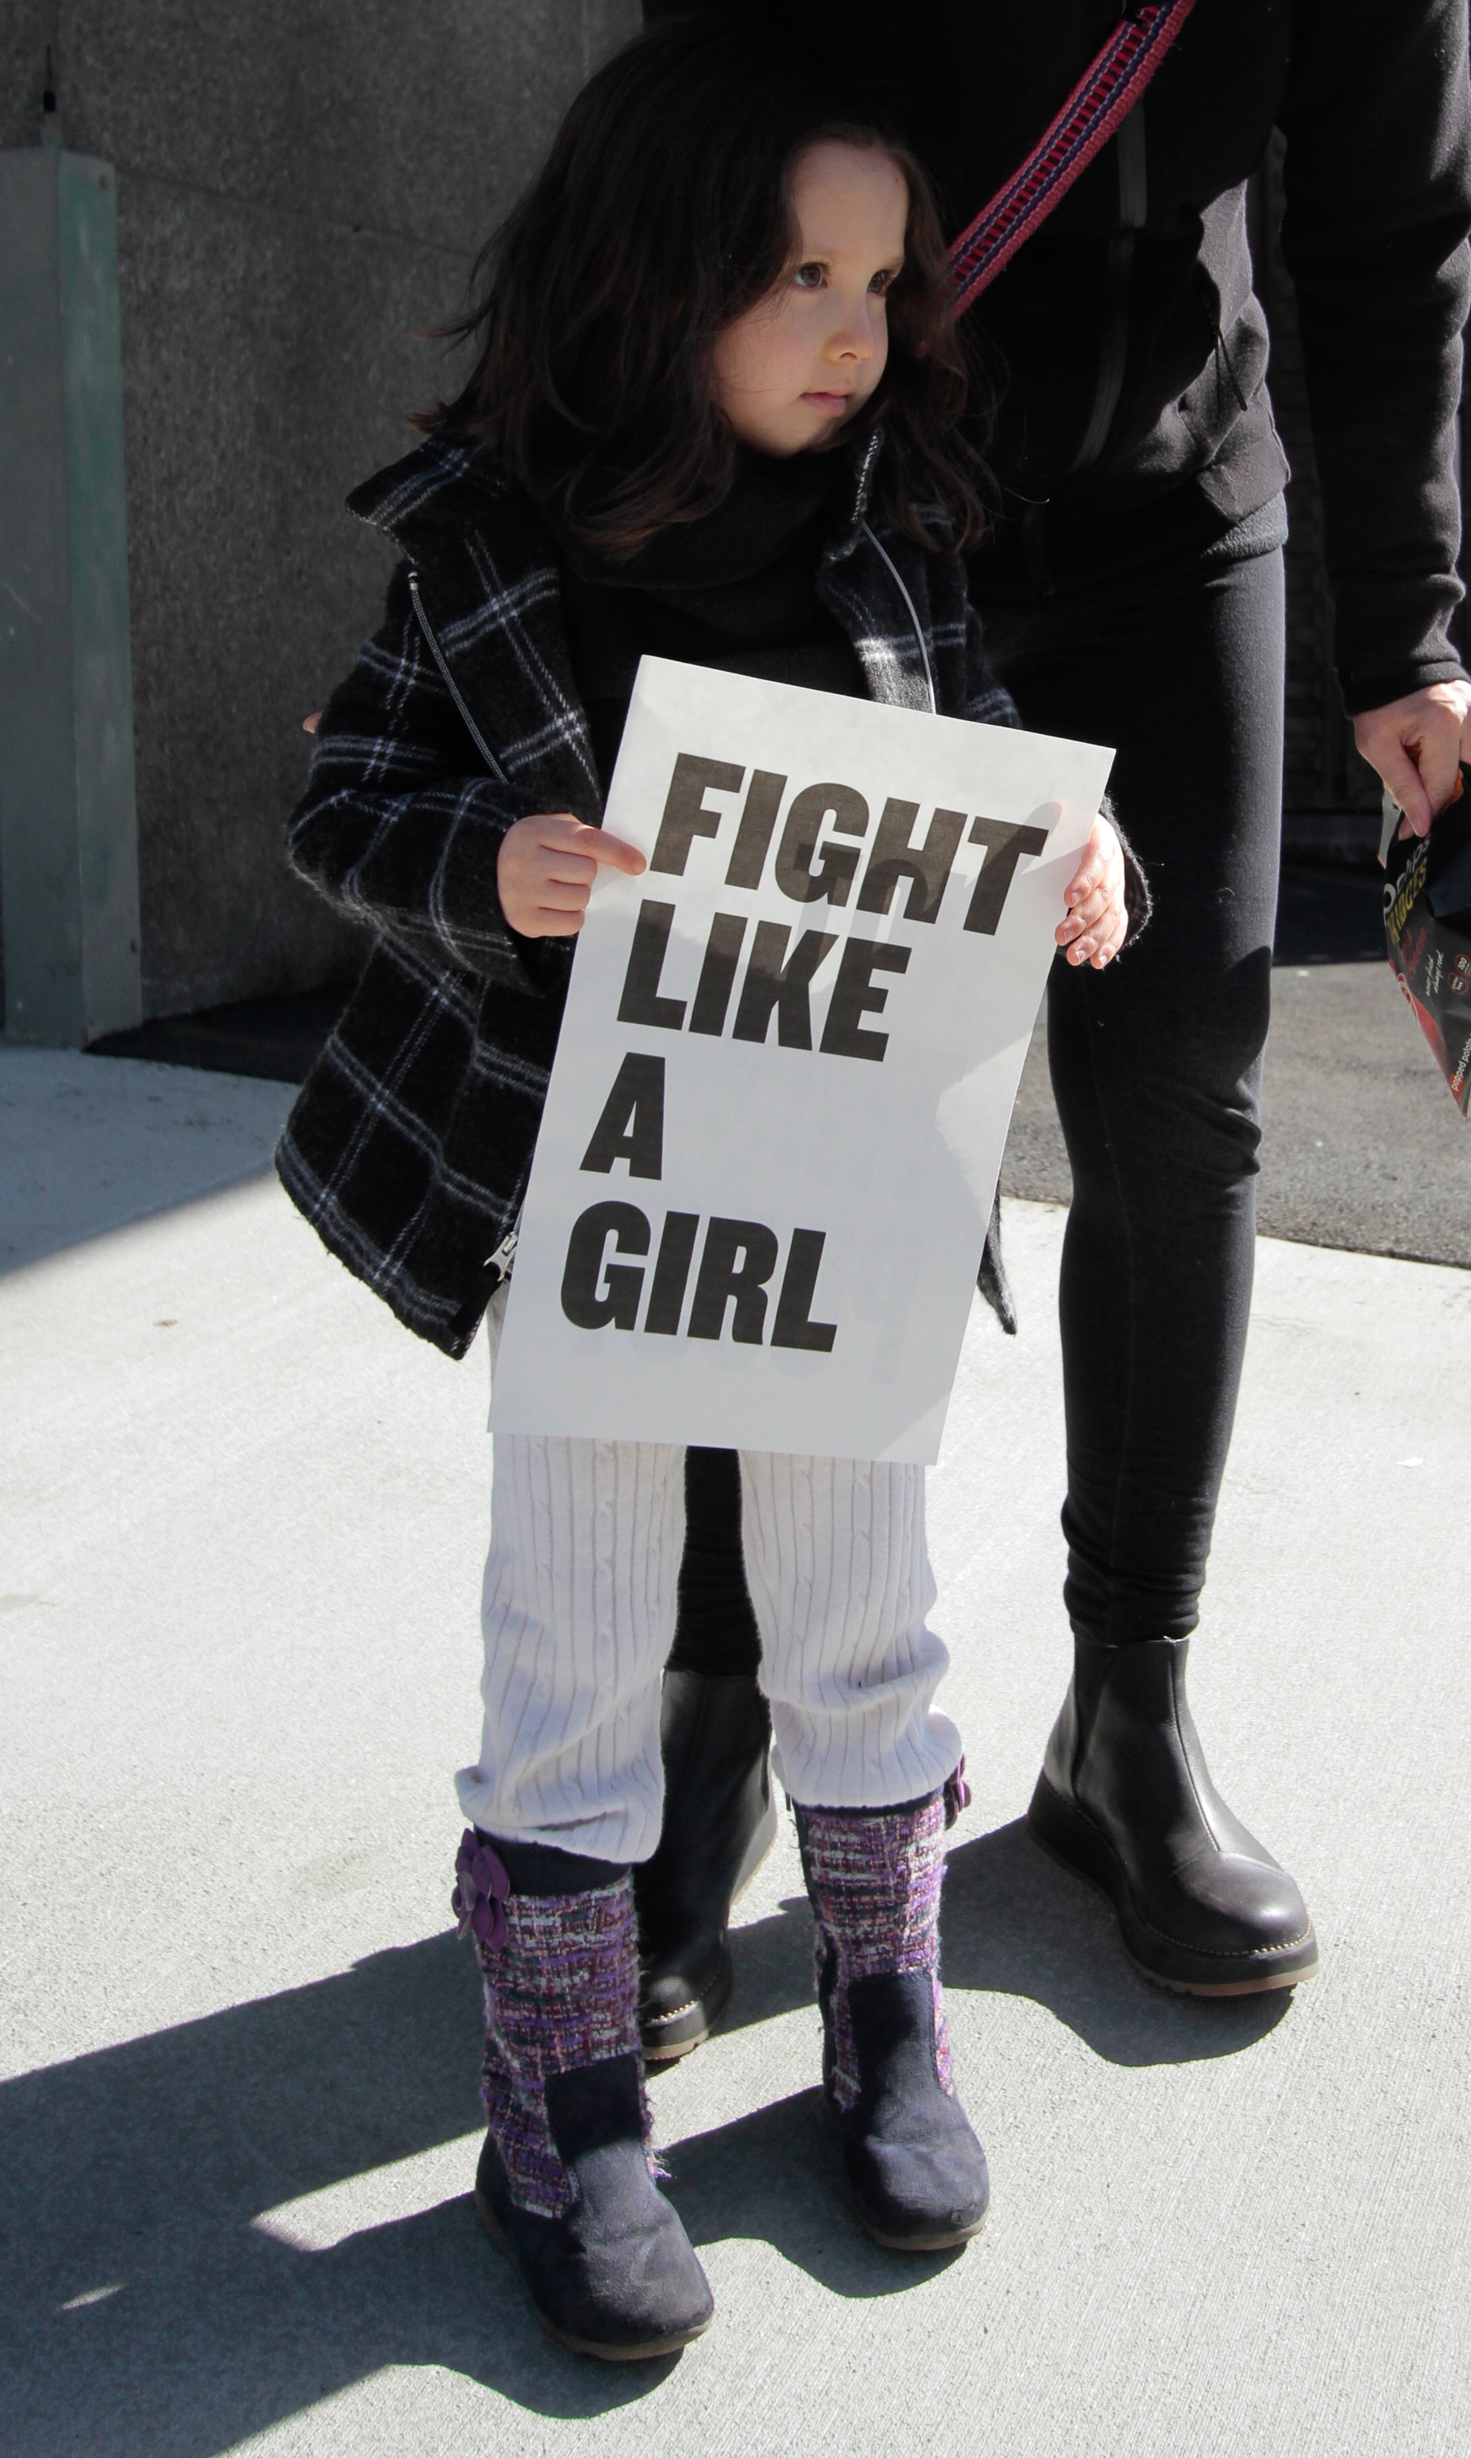
GIVE LIFE CHANGING
OPPORTUNITIES FOR
GREAT FUTURES!
DONATION LEVEL SUGGESTIONS:
$25 – Two children’s books that inspire a love a reading and enhanced literacy skills
$50 – A gas card that allows a patient the ability to travel to and from dialysis appointments
$100 – Safe and monitored childcare in house for two children while their mother is in a counseling appointment
$250 – 10 sets of new linens for our hospice patients’ beds
$500 – Covers one month’s payments on our safe ride service’s van to transport elderly adults on errands and to doctor’s appointments
$1,000 – A new motorized wheelchair to give our patients back their mobility and independence
$2,500 – A new hospital bed for patients to use in their homes or in part of our hospice facility
$5,000 – Covers our building’s utilities and rent for one month so we may continue to provide community workshops for children, teens, and elderly adults
WHERE DO I DONATE?
Visit our website at: <insert web address>
SUPPORT YOUR COMMUNITY!
Join <insert charity name> in our pursuit to <mission/impact statement> by donating today. With your donation, you’ll support <insert charity name> in our ability to service our local <insert city name> community and stop <insert prevention/service need> in its tracks.
YOUR DOLLARS MAKE A DIFFERENCE
Every dollar donated goes directly into our programs and service to make <insert city name/service area> a safer, healthier community. Each level below provides <insert charity name> the ability to make a meaningful impact.
MAKE AN IMPACT IN OUR COMMUNITY TO SUPPORT…
<insert your key demographics>.
INSERT LOGO
CONTACT US! <Contact Name> <Email Address> <Phone Number>

