Slide 1


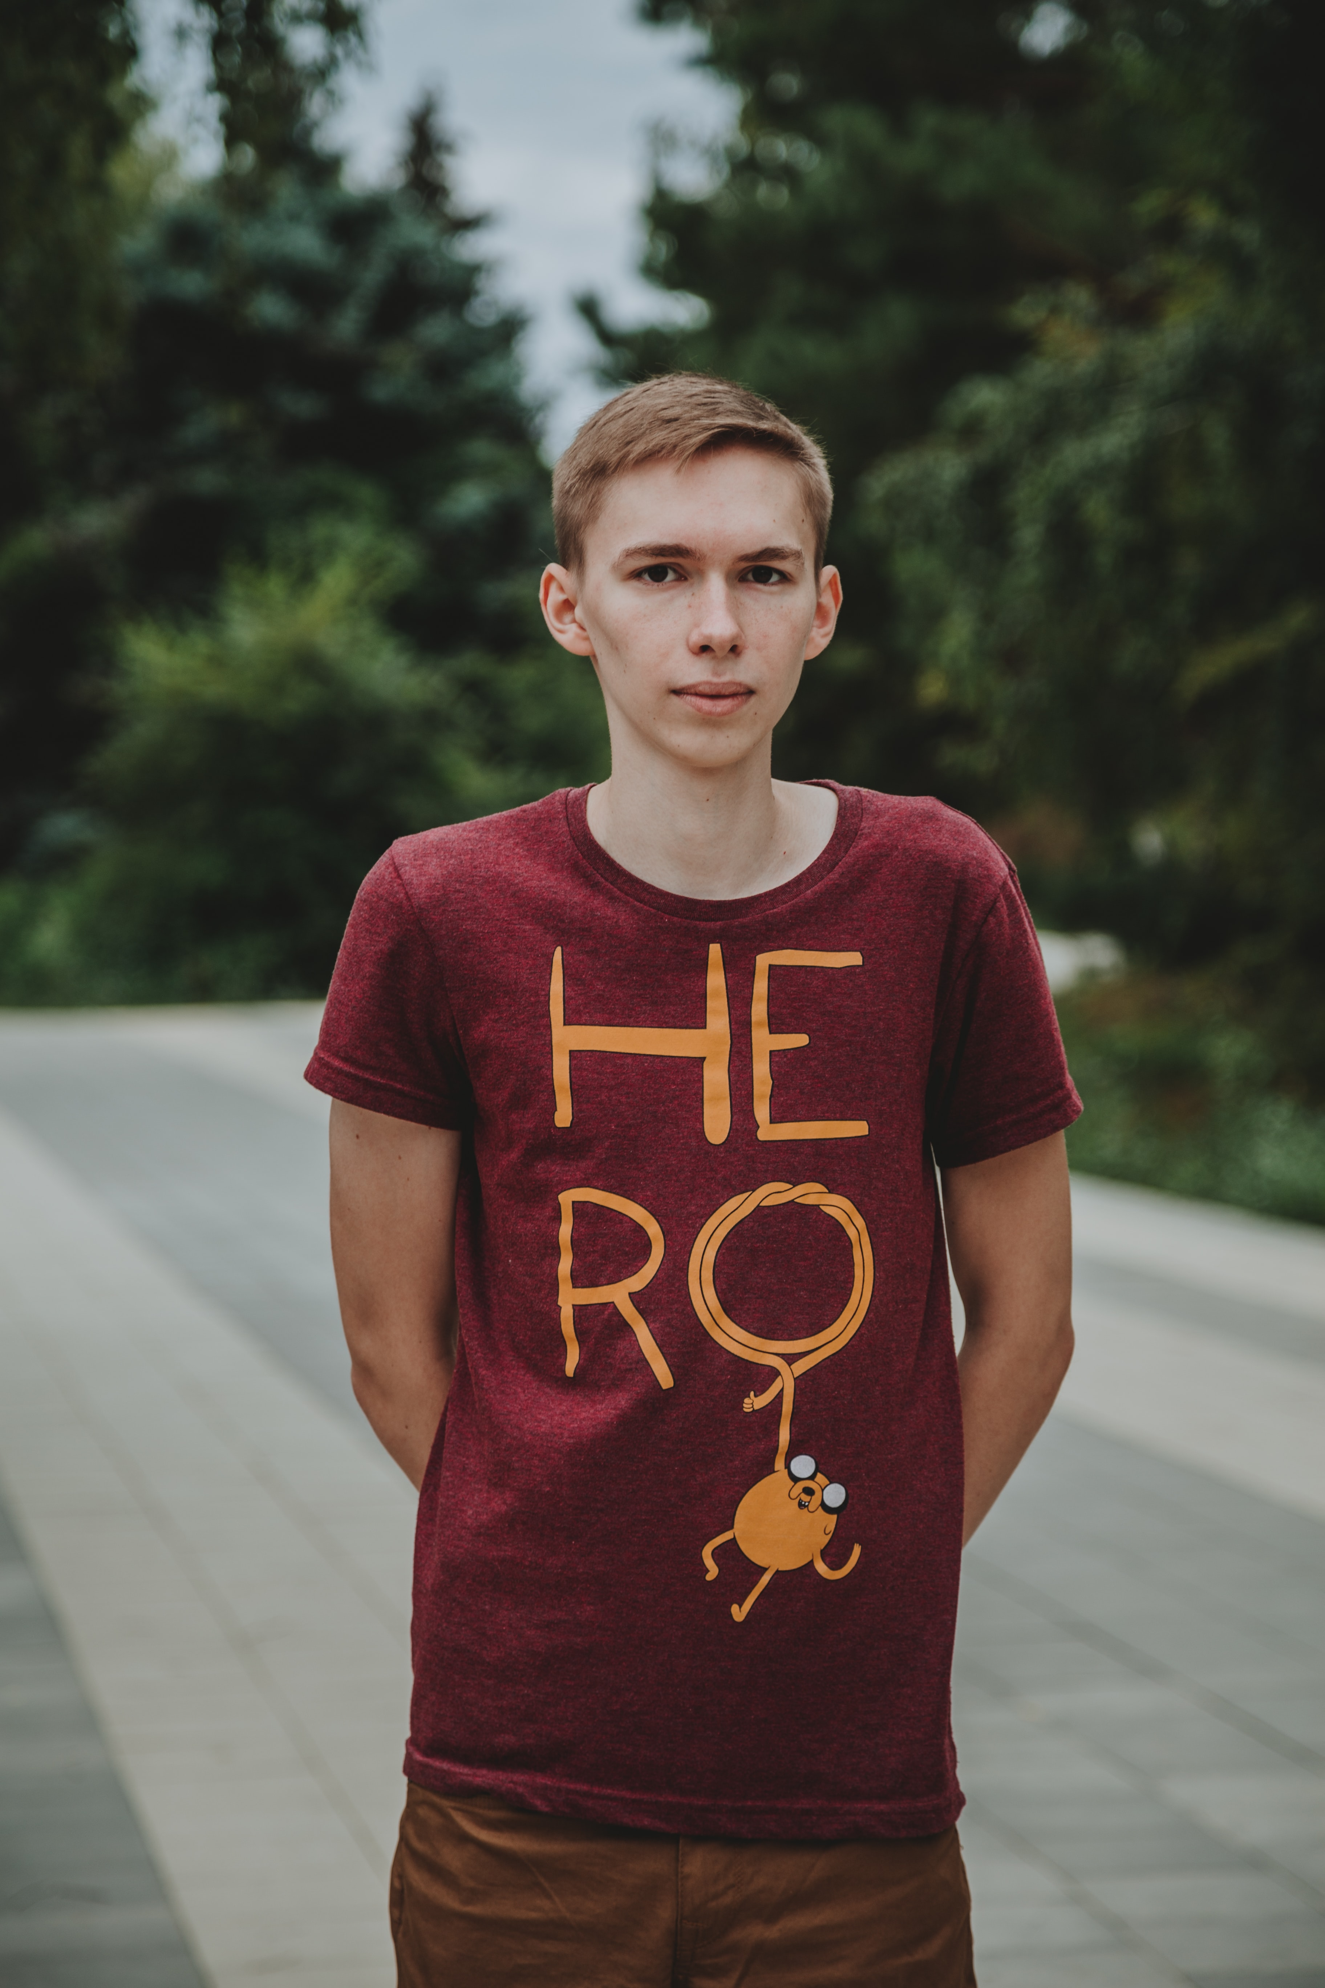
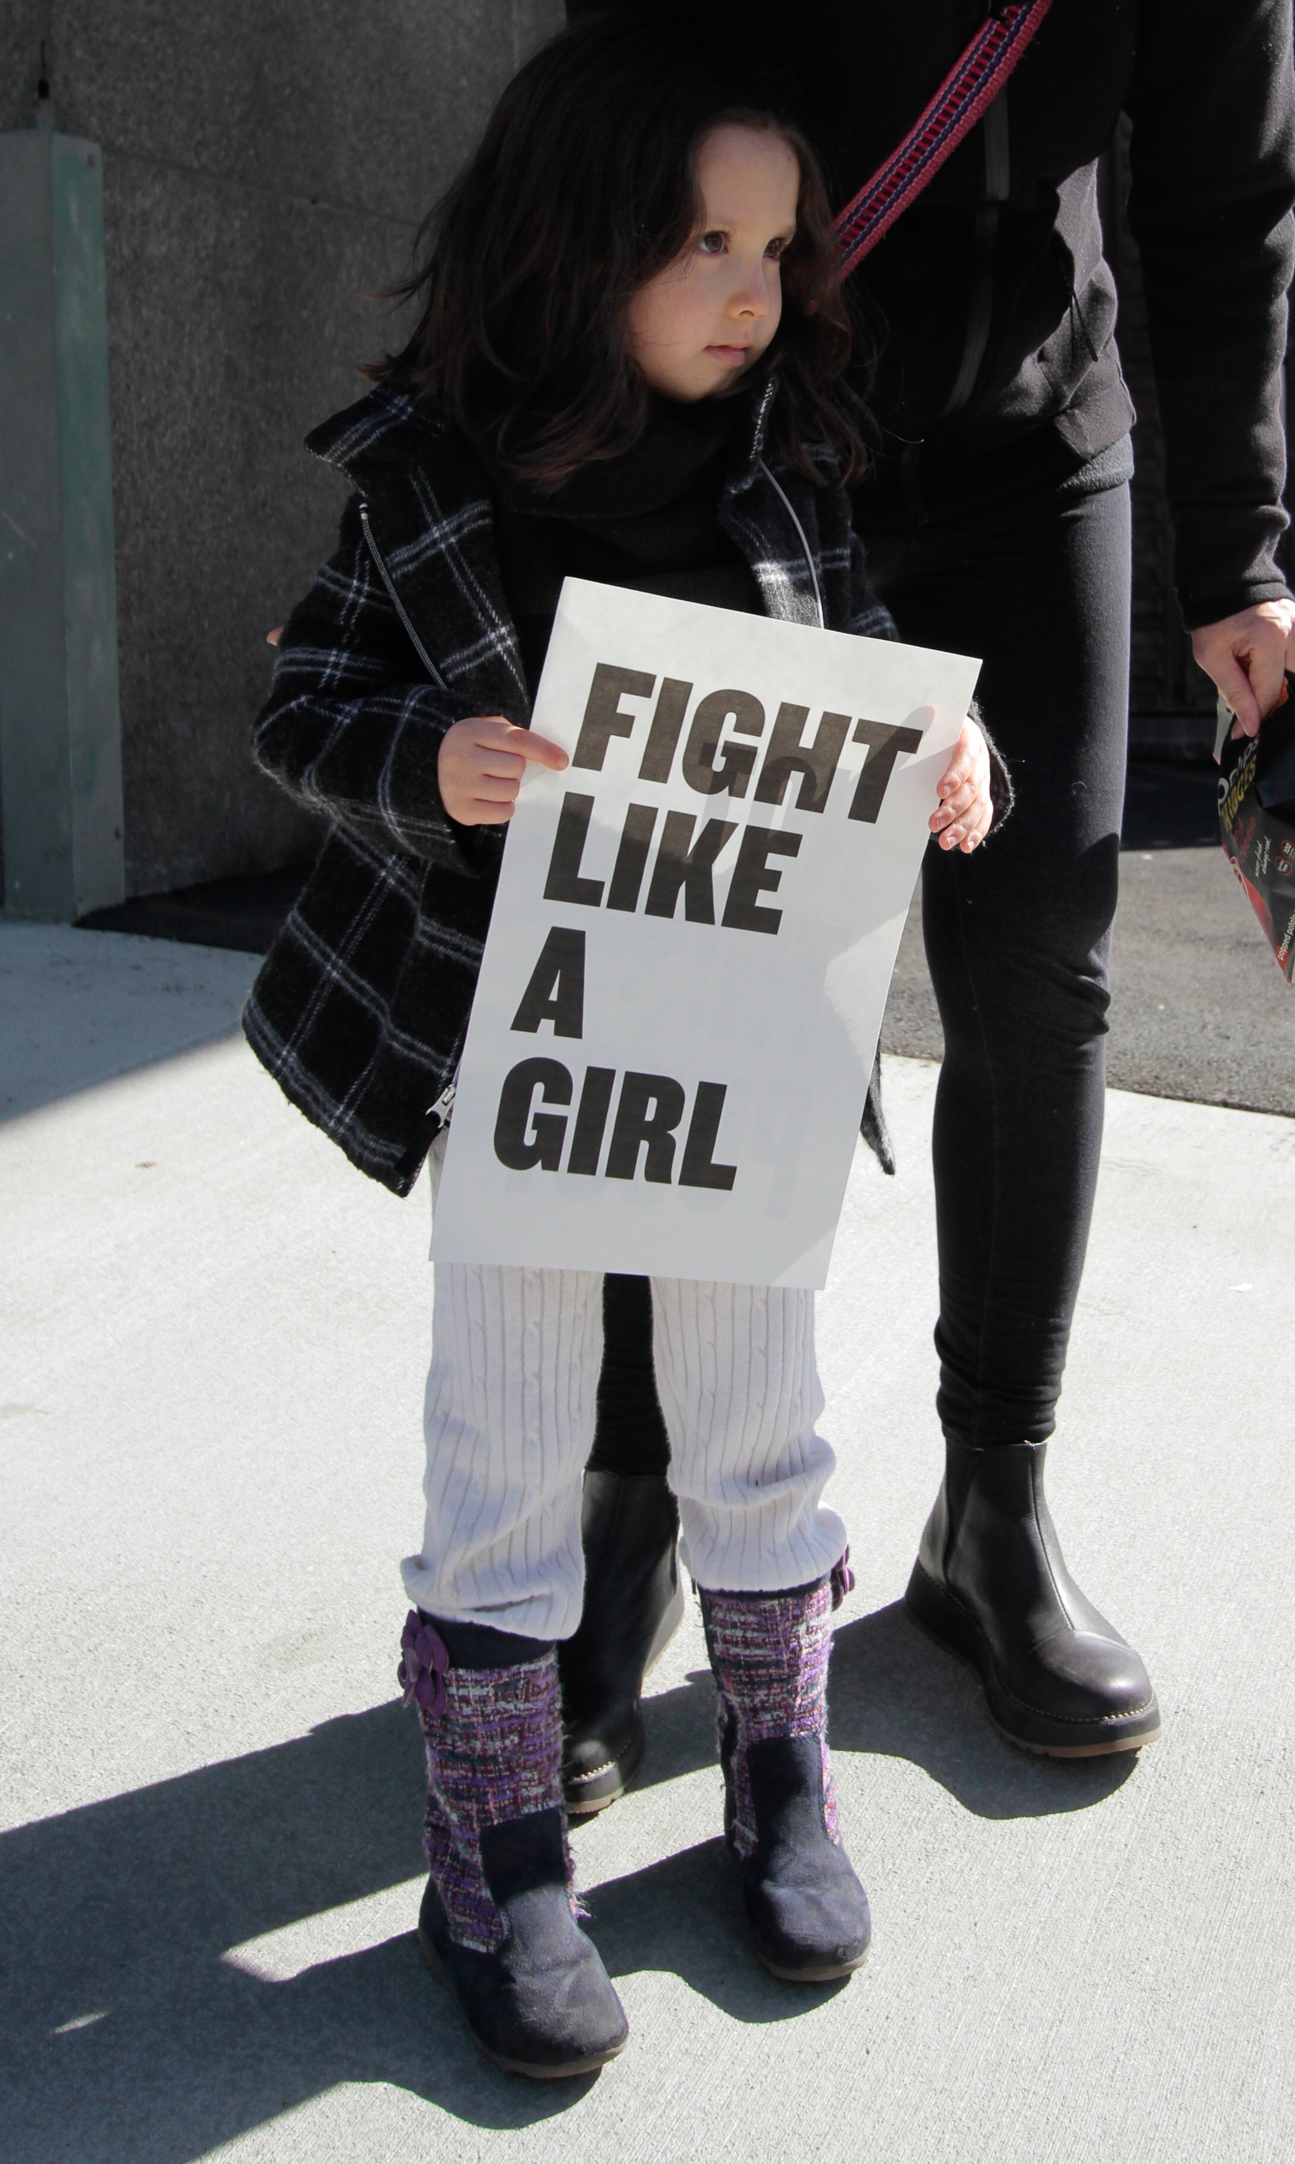
GIVE LIFE CHANGING OPPORTUNITIES FOR
GREAT FUTURES!
INSERT LOGO
SUPPORT YOUR COMMUNITY!
Join <insert charity name> in our pursuit to <mission/impact statement> by donating today. With your donation, you’ll support <insert charity name> in our ability to service our local <insert city name> community and stop <insert prevention/service need> in its tracks.
YOUR DOLLARS MAKE A DIFFERENCE
Every dollar donated goes directly into our programs and service to make <insert city name/service area> a safer, healthier community. Each level below provides
<insert charity name> the ability to make a meaningful impact.
MAKE AN IMPACT IN OUR COMMUNITY TO SUPPORT…
<insert your key demographics>
DONATE TODAY!
$25
$50
$100
$250
$500
$1,000
$2,500
$5,000
Two children’s books that inspire a love a reading and enhanced literacy skills
A gas card that allows a patient the ability to travel to and from dialysis appointments
Safe and monitored childcare in house for two children while their mother is in a counseling appointment
10 sets of new linens for our hospice patients’ beds
Covers one month’s payments on our safe ride service’s van to transport elderly adults on errands and to doctor’s appointment
A new motorized wheelchair to give our patients back their mobility and independence
A new hospital bed for patients to use in their homes or in part of our hospice facility
Covers our building’s utilities and rent for one month so we may continue to provide community
workshops for children, teens, and elderly adults
CONTACT US! <Contact Name> <Email Address> <Phone Number>

